Slide 1
Scheduler Algorithms
Under supervisor:
DR/Mohamed Mahmoud Ibrahim

Slide 2
TEAM’S MEMBER:
Eman Kamel Ashry
Fedaa Shaban Mohamed
Mohamed Ragab Radwan
Mariam Ahmed Sayed
Alaa Anwar Faysal

Slide 3
Content :
Round Robin Algorithm
Earliest Deadline First (EDF) Algorithm

Slide 4
ROUND ROBIN (RR)

Slide 5
ROUND ROBIN (RR):
Round Robin scheduling is a preemptive algorithm where each process is assigned a fixed time slice or quantum.
the CPU scheduler rotates among the processes, allowing each to execute for a predefined time interval
q large =>FIFO
q small => q must be large with respect to context switch, otherwise overhead is too high

Slide 6
Advantage & Disadvantage of RR:
Advantage:
It doesn’t face the issues of starvation or convoy effect.
All the jobs get a fair allocation of CPU.
It gives the best performance in terms of average response time
Disadvantages:
1-This method spends more time on context switching
2-Round-robin scheduling doesn’t give special priority to more important tasks.
3-Lower time quantum results in higher the context switching overhead in the system.

Slide 7
Earliest Deadline First (EDF) Algorithm

Slide 8
Earliest Deadline First (EDF) Algorithm:
Earliest Deadline First (EDF) is an optimal dynamic priority scheduling algorithm used in real-time systems.
It can be used for both static and dynamic real-time scheduling.
Priorities are assigned according to deadlines:
the earlier the deadline, the higher the priority
the later the deadline, the lower the priority

Slide 9
Advantage & Disadvantage of EDF:
Advantage:
EDF minimizes the chances of missing deadlines and helps meet real-time requirements.
Flexibility: EDF can handle both periodic and aperiodic tasks,
Disadvantages:
Priority Inversion:
In systems where multiple tasks share resources, a lower-priority task holding a resource needed by a higher-priority task can cause the higher-priority task to be delayed.
.

Slide 10
Scheduler implementation in python

Slide 11
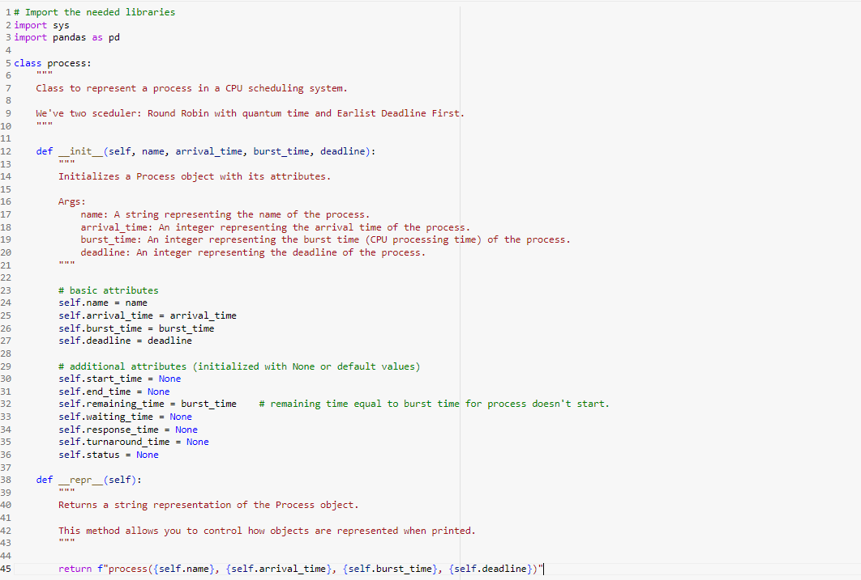

Slide 12
Explain :
we create process class , That contains two functions :
_init_: Initializes the process attributes.
There are two type of attributes:
_repr_: Provides a string representation of the process object for easy printing
Basic attribute
additional attributes

Slide 13
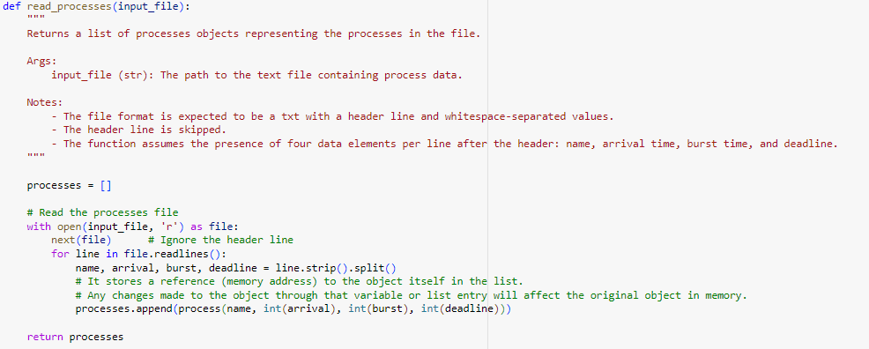

Slide 14
Explain :
we use this function in order to read external txt file
with comma separate or csv file
steps :
define processes list to define all processes that has arrived
open the file , then read line by line
each line contains name, arrival, burst, deadline values which separated by comma , we split each value and put it in process attributes by using constructor
(process(name, int(arrival), int(burst), int(deadline))
4- The newly created process object is then appended to the processes list.
This function return list of the processes that we will used in our algorithm .
Note :
All processes in the list is passive that actually stored in Hard disk

Slide 15
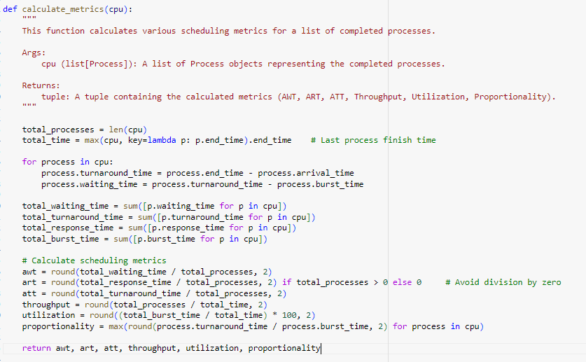

Slide 16
Explain :
Calculates various performance metrics for the scheduling algorithms
This function return awt, art, att, throughput, utilization, proportionality

Slide 17
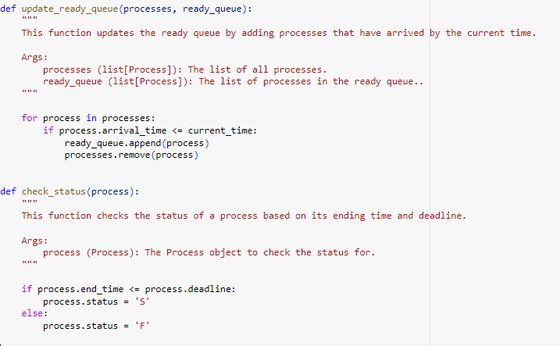

Slide 18
Explain :
queue(processes, ready_queue) function :
we use it in order to take process from processes list to ready queue
it like long term schedular ), it done by comparing the arrival time of process with
current time for all processes list , if arrival time less or equal to current time ,
then add to ready queue and remove it from processes list
check_status(process) function :
Use it to check if the executable process meets it’s deadline or not .
If the process meets it’s deadline ,it’s status => s which means successful
If not ,process’s status => F which means Failed

Slide 19
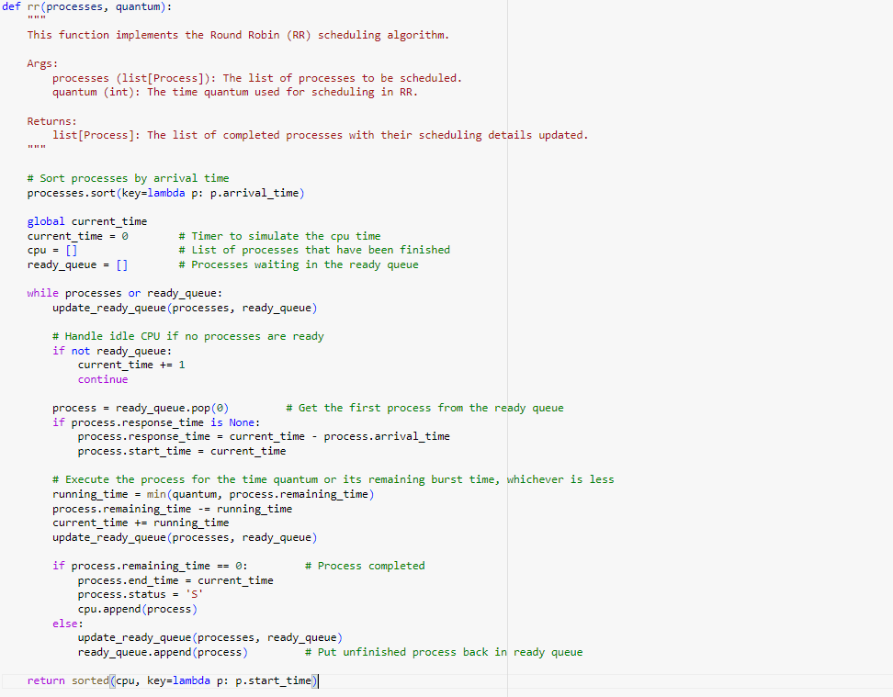

Slide 20
Round Robin :
We sort the processes in list by its arrival time to know which come first
We define cpu list to put the complete it’s execution and ready queue to hold the processes that have been arrived
while there is any process in ready queue or processes :
We check if there is an arrival process in this current time using queue()
If there is no processes in ready queue , we add idle processes until any process arrive the ready queue .
If process arrives , we get it from the ready queue ,
We add this condition (process.response_time is None) , as we want to response time to the process , if we remove it and only process in ready queue ,we will assign wrong response time to the process as amount of time it takes from when a request was submitted until the first response is produced, not output

Slide 21
Round Robin CON’D :
By taking the minimum of these two values, the code ensures that the process will not run for longer than the quantum time slice allocated to it by the scheduler.
The we remove the running time form the burst time of this process , increment the current by the process running time , then check if we have any arrival process at this current time or the time less than
We can check for arrival process , by increment the current time by one , but we know that if any process arrives while another process come it will not replace the executing process .
After that , we check if the Process completed or not , if it complete then make status of process successful , then append it to CPU list .
Else it will check if any arrival process to add to the ready queue
The return parameter is the CPU list

Slide 22
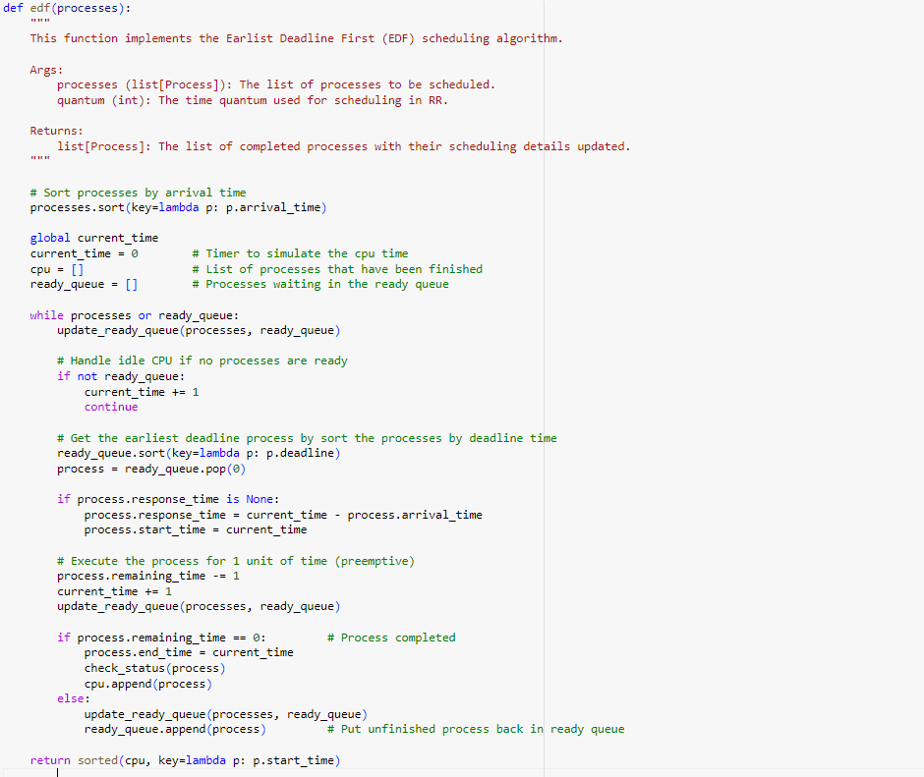

Slide 23
Earliest Deadline First (EDF) :
we sorted the processes in ready queue by their deadlines so we can execute the process with the shortest deadline first
We define cpu list to put the complete it’s execution and ready queue to hold the processes that have been arrived (main memory)
while there is any process in ready queue or processes :
We check if there is an arrival process in this current time using queue()
If there is no processes in ready queue , we add idle processes until any process arrive the ready queue .
If process arrives , we get it from the ready queue into cpu (short handler scheduler),
We add this condition (process.response_time is None) , as we want to response time to the process , if we remove it and only process in ready queue ,we will assign wrong response time to the process as amount of time it takes from when a request was submitted until the first response is produced, not output

Slide 24
Earliest Deadline First CON’D :
By taking the minimum of these two values, the code ensures that the process will not run for longer than the quantum time slice allocated to it by the scheduler.
process.remaining_time -= 1
current_time += 1
queue(processes, ready_queue)
>> we decrease the remaining time by 1 unit and increase the current time by 1 unit then we check if there is any other process with earlier deadline than the process in execution phase , if there then we replace it with the new process and execute it and continue every one unit of time to make sure that the process with the earliest deadline is executed first.
After that , we check if the Process completed or not , if it complete then check the status if S or F , then append it to CPU list .
Else it will check if any arrival process to add to the ready queue
The return parameter is the CPU list

Slide 25
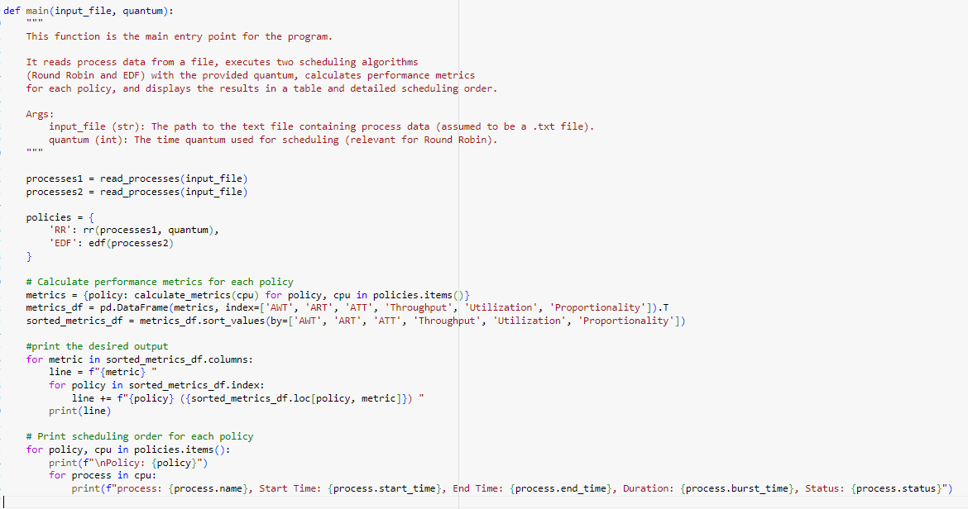

Slide 26
Main program :
At first we declared two variables processes1 and processes2 and assigned to them the input files then we created a dictionary called policies which have two policies Round Robin (rr) its key is 'RR' and its value is rr(processes1, quantum) , and Earliest Deadline First (edf) its 'EDF' and its value is edf(processes2)
creating a dictionary called metrics , iterated over each pair in the policies dictionary and do the calculation of each policy ( the metrics of every process in cpu of every scheduling algorithm ) so it includes ( AWT , ART , ATT , Throughput , Utilization , Proportionality ) of every process
metrics_df is for organizing metrics as requiered , pd.DataFrame represent the indices with [ AWT , ART , ATT , Throughput , Utilization , Proportionality ]for printing metrics in table we sorted the rows based on the calculated metrics , then converts the sorted DataFrame int a human_readable string format to print the sorted metrics in a tabular format
for printing policies we have for loop for each pair of (policy , cpu) in policies and print the policy key then there is another for loop inside the first one which iterates over every process in the cpu and print its ( name , start time , end time , duration , status )so it first prints the RR then the EDf policices

Slide 27
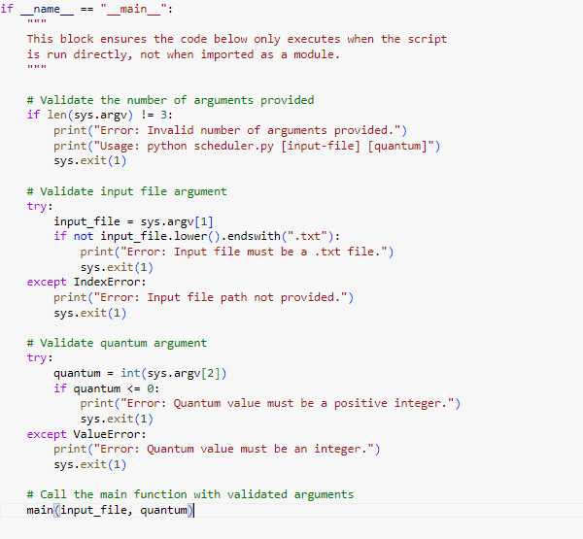

Slide 28
The code checks if the script is being run as the main program
(if __name__ == "__main__":) rather than being imported as a module.
Inside the if block, the code checks if the correct number of command-line arguments have been provided.
The script expects exactly 3 arguments: the script name, the input file, and the quantum value.
if the number of arguments is not 3, the script prints a usage message and exits indicating an error.
If the number of arguments is correct:
Validate input file argument:
the script assigns the first command-line argument (excluding the script name) to the input_file variable
checks if the input_file string (after being converted to lowercase) ends with the ".txt" extension.
indicating that the input file is vaild or not a valid ".txt" file.

Slide 29
Validate quantum argument:
the second command-line argument to the quantum variable (after converting it to an integer).
We need to handle the value of the quantum :
The quantum must be positive , so if it less than zero , print an error message and exit.
If converting the value of quantum is failed , the ValueError exception is raised, and the script prints an error message and exits
Finally, the script calls the main function, passing the input_file and quantum as arguments

Slide 30
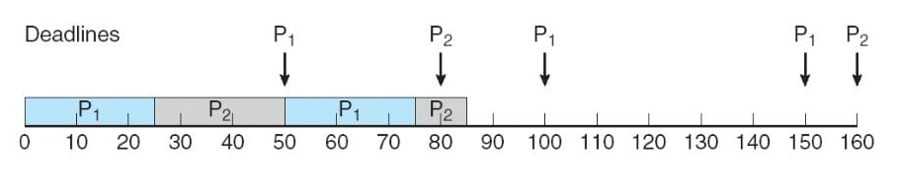
Notes :
In ideal cpu , if the process doesn’t meet it’s deadline in EDF , we stop it and didn’t allow it to complete it’s execution as it has failed as it may cause another process to miss it’s deadline
In our project we consider it will complete it’s execution , we depend on the reference , as p2 missed its deadline at 80 and continued excution until 85
We consider that the context switch time is very small , we ignore it .

Slide 31
UML & Sequence Diagram

Slide 32
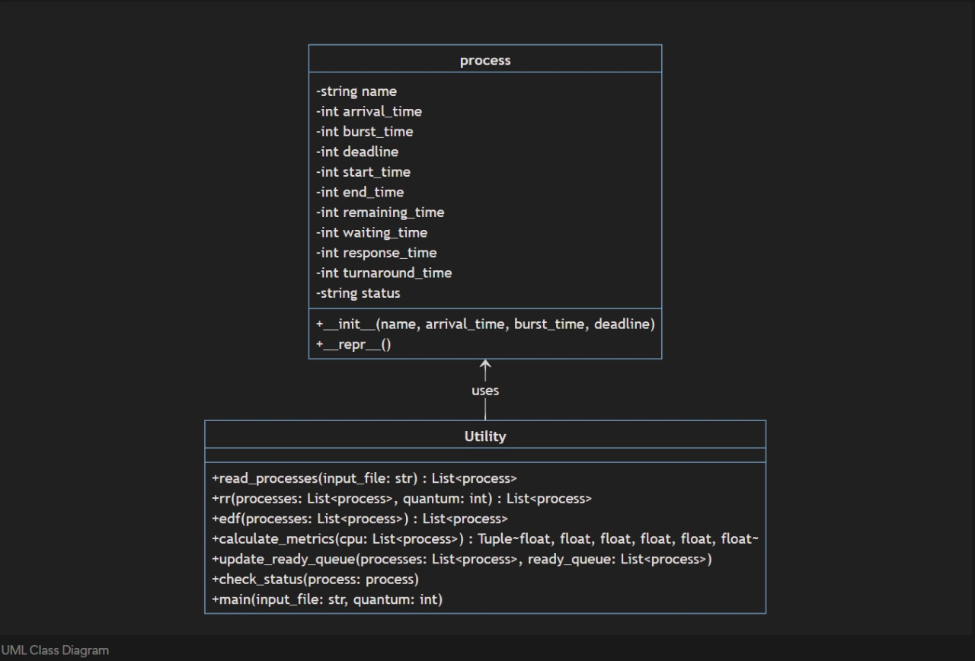

Slide 33
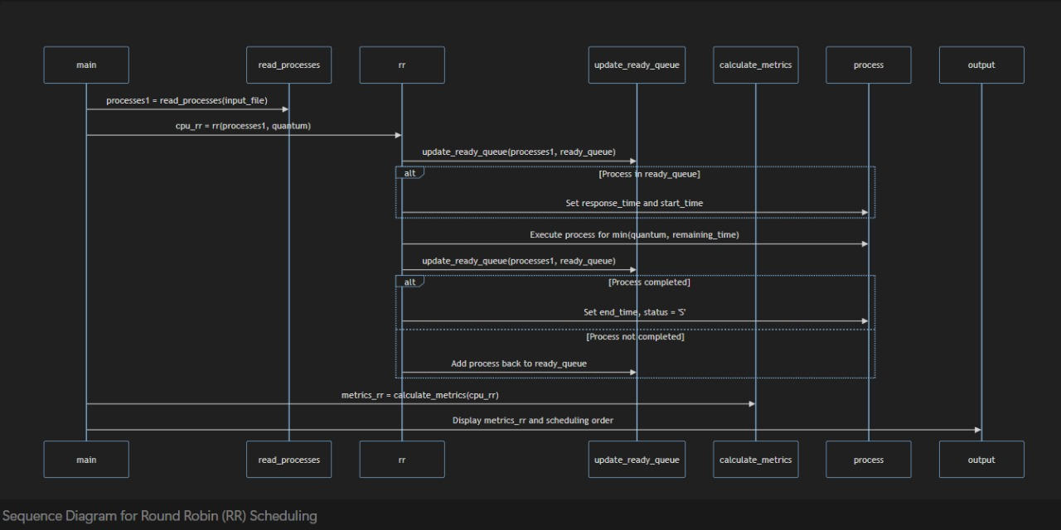

Slide 34
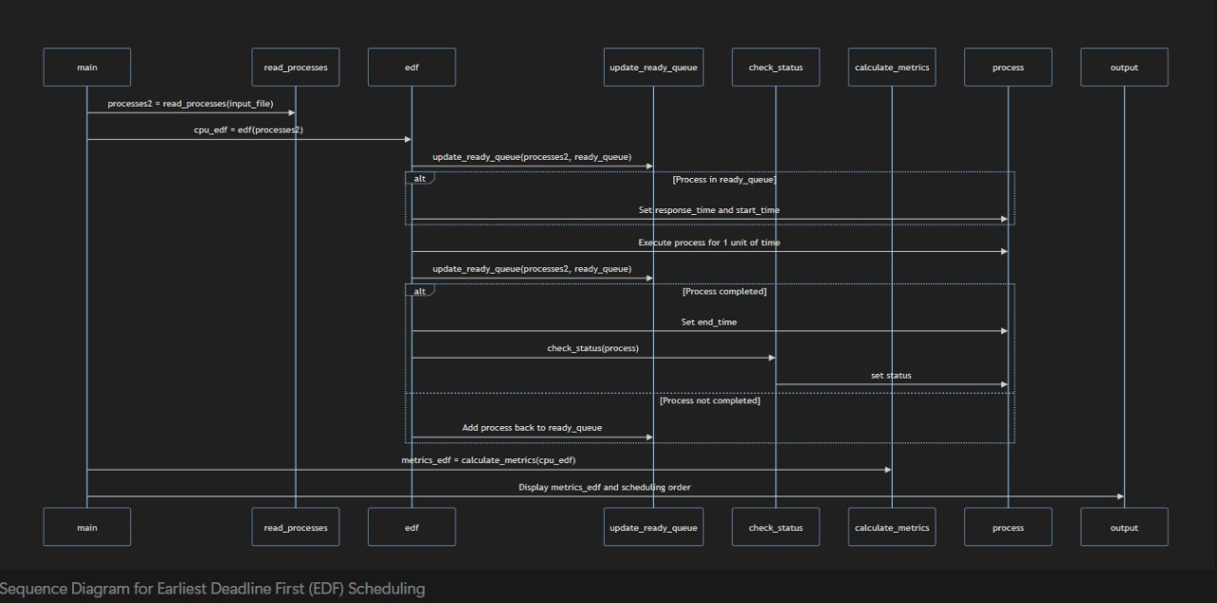

Slide 35
Test input & the output

Slide 36
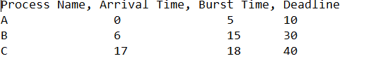
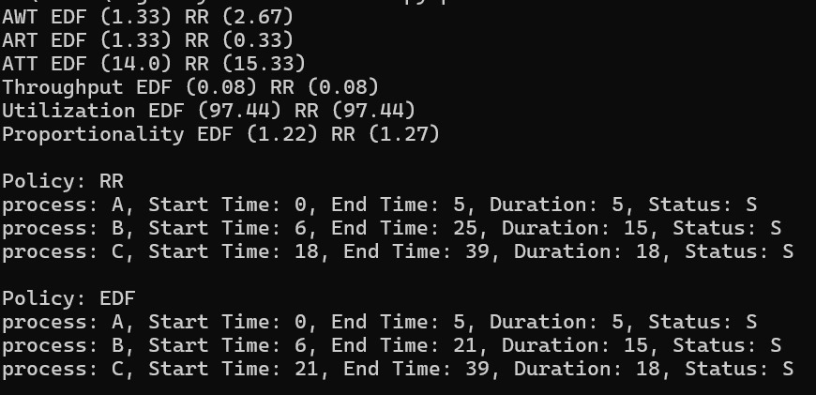
The input file:
The output :
Command: Python scheduler.py processes1.txt 2

Slide 37
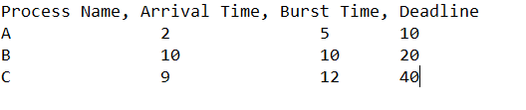
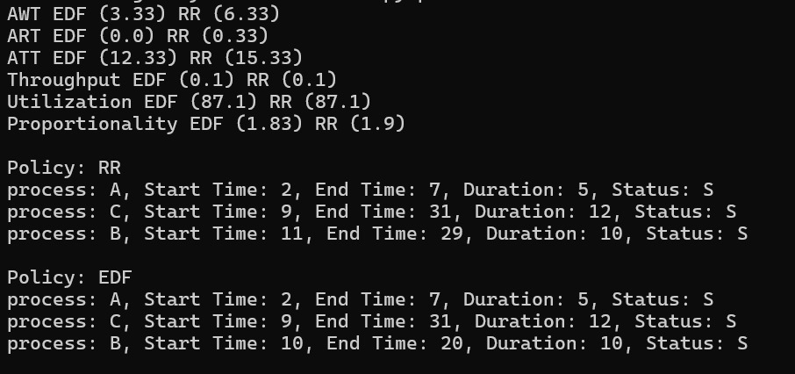
The input file:
The output :
Command: Python scheduler.py processes2.txt 2

Slide 38
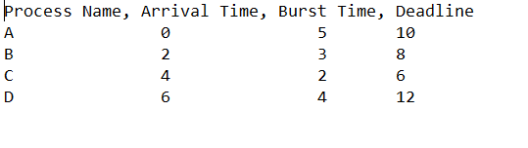
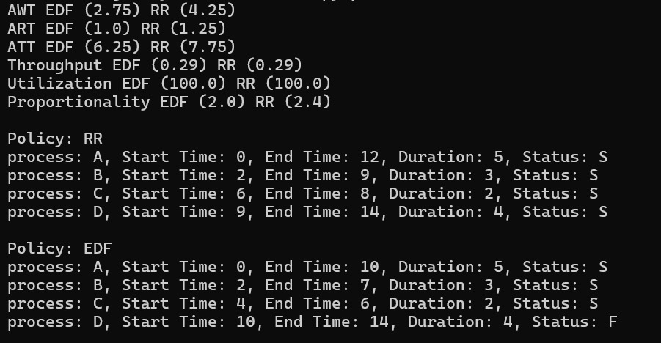
The input file:
The output :
Command: Python scheduler.py processes3.txt 2

Slide 39
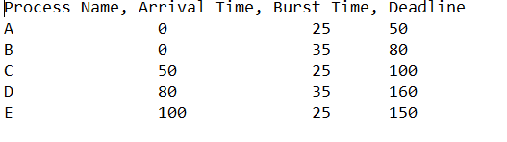
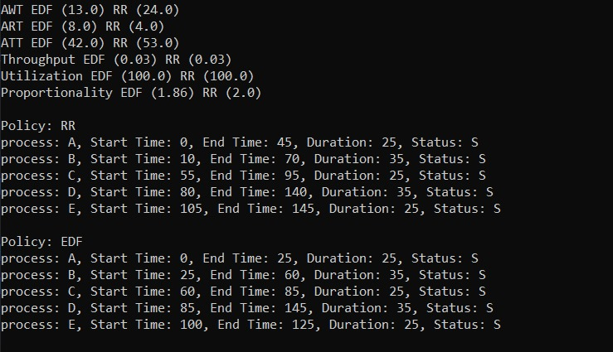
The input file:
The output :
Command: Python scheduler.py processes4.txt 10

Slide 40
Calculation

Slide 41
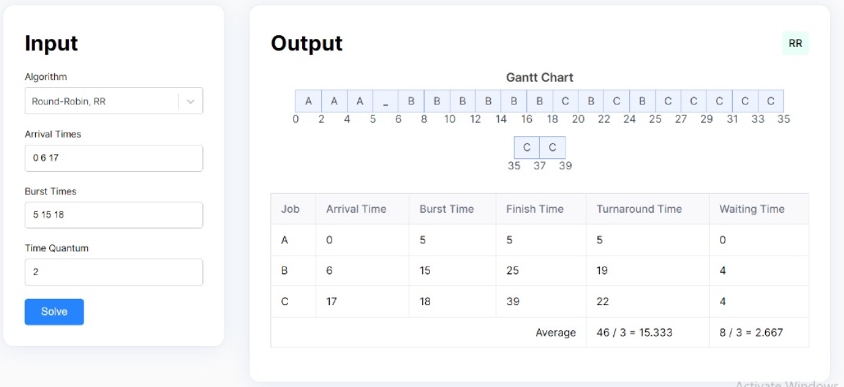

Slide 42
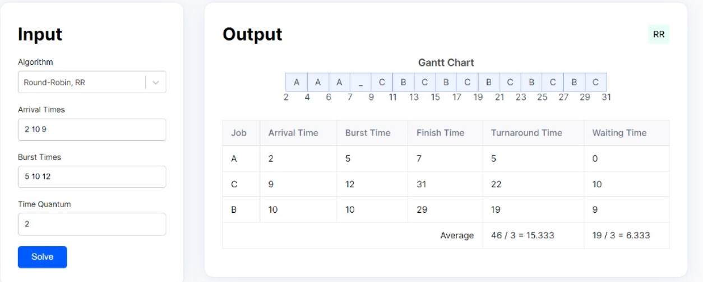

Slide 43
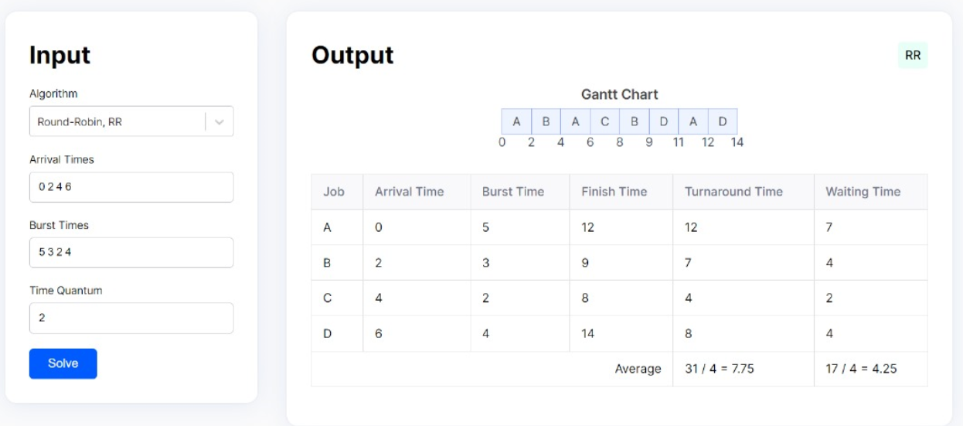

Slide 44
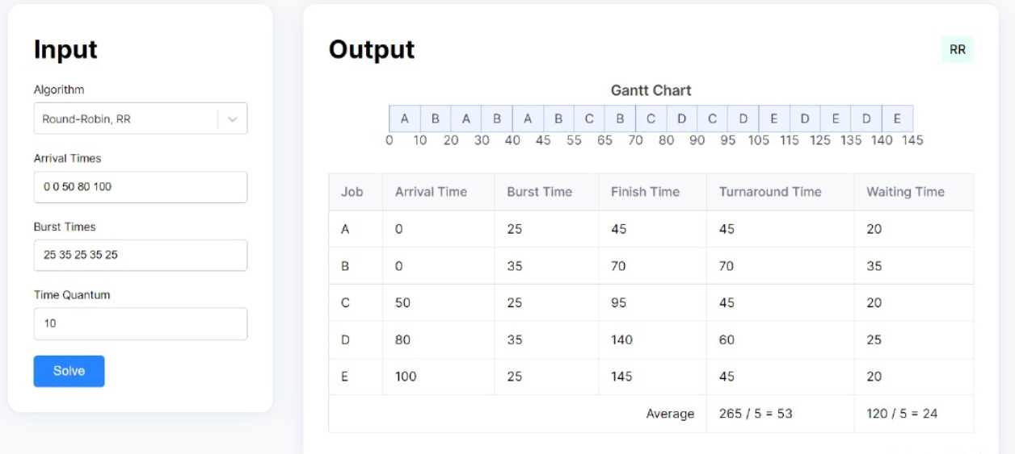

Slide 45
Thank you

